Slide 1
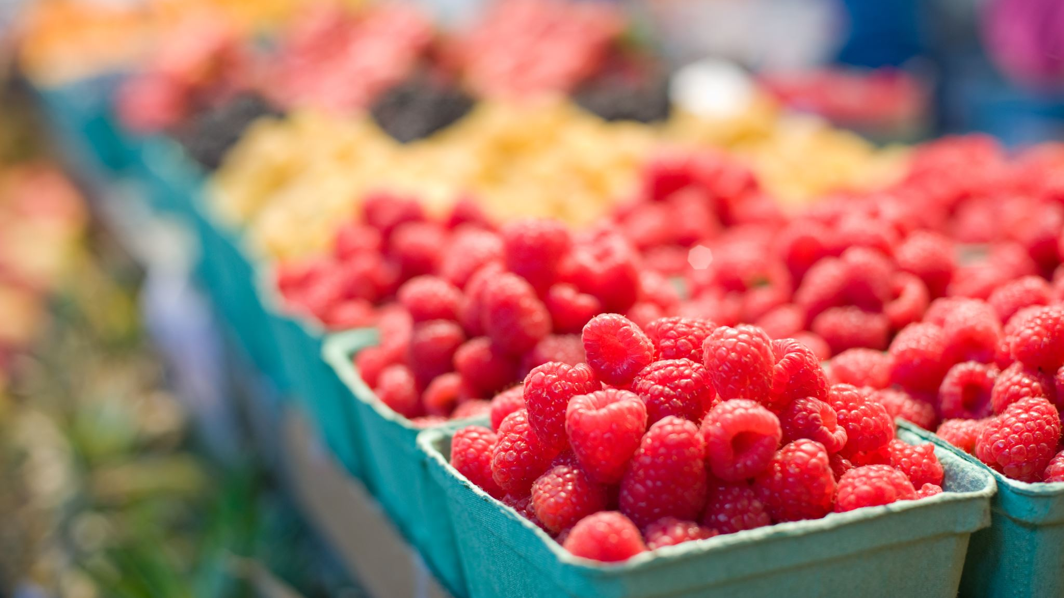
Instacart Market Basket Analysis

Slide 2
Group 1 Atharva Tipre- aat18009 Vedant Taneja – vxt190003 Sidhant Kapoor- sxk144030 Avinash Panigrahi-axp190034

Slide 3
About Instacart
Instacart is an American company that operates grocery delivery and pick up service in United States and Canada
Instacart demonstrates benchmark practices for using transactional data to build models determining which products will be bought together by a customer, the probability of adding a new products to the cart and the estimated time of next purchase
Instacart is also active in hosting competitions for building best in use algorithms to predict customer behavior and improve user experience

Slide 4
Problem Statement
Using the data set, we are trying to address the following question
Predict whether product items will be reordered in the future by customers or not

Slide 5
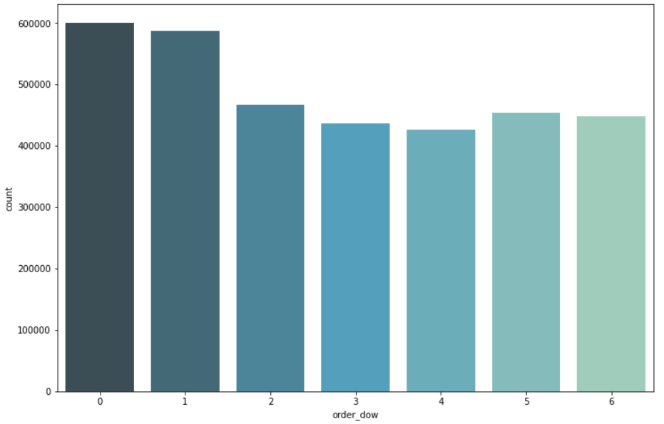
Exploratory Data Analysis
Weekly Analysis
As per our analysis, the following observations were made
Maximum number of orders were placed on Sunday
Minimum number of orders were placed on Thursday

Slide 6
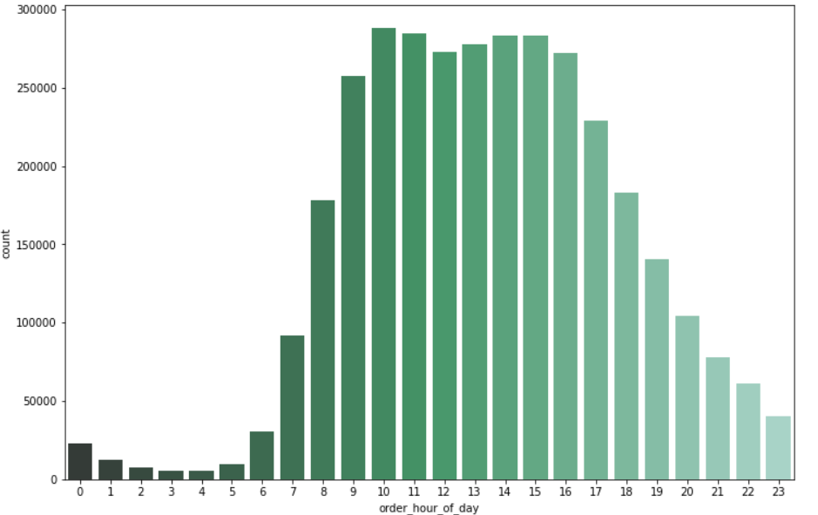
Hourly Analysis
As per our analysis, the following observations were made
On Weekdays, most of the orders are placed in the morning 10Am-12Pm
On Weekends, most of the orders are placed in the afternoon 2Pm- 4Pm

Slide 7
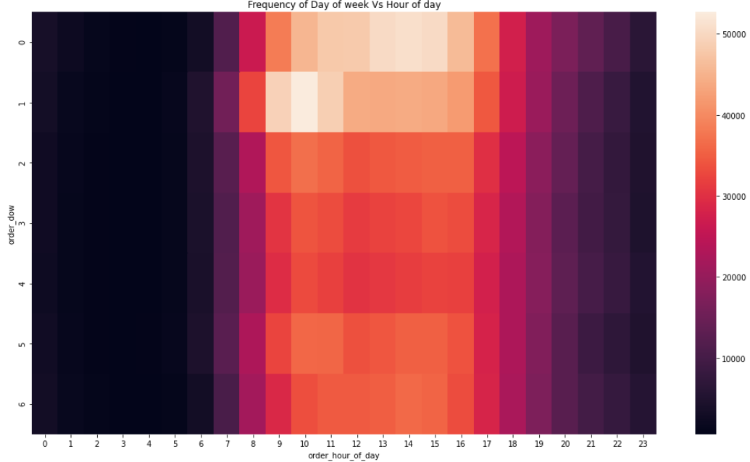
Let’s see Hour of Day Vs Day of Week Comparison
In the given heat map, we can see that there is a clear peak in the orders during Sundays and Monday from 9:00Am to 4:30 Pm

Slide 8
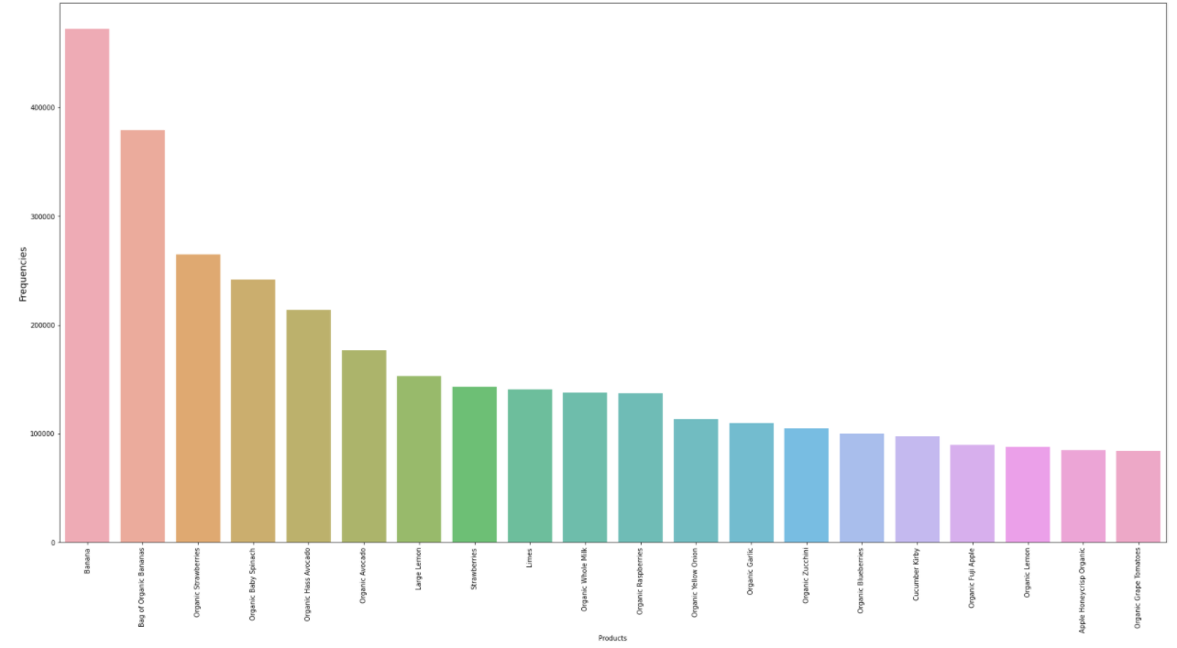
The graph depicts the frequency of the products ordered
The bar graph indicates the top ordered products by customers and their respective frequencies
As seen fruits and vegetables top the list for the mostly frequently bought products

Slide 9
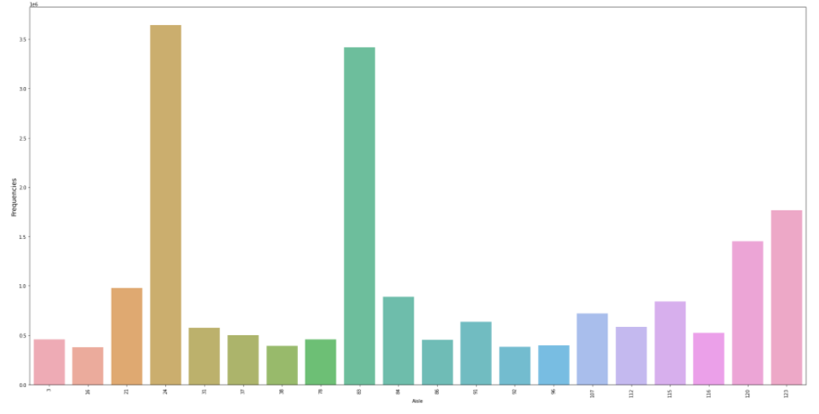
The graph depicts the frequency of items ordered from different aisles
This graph reiterates the point made in the above slide concerning the most frequently purchased products
It can be clearly seen that the fruit and vegetable aisles have a significantly higher number of orders than for the aisles stocking other product categories

Slide 10
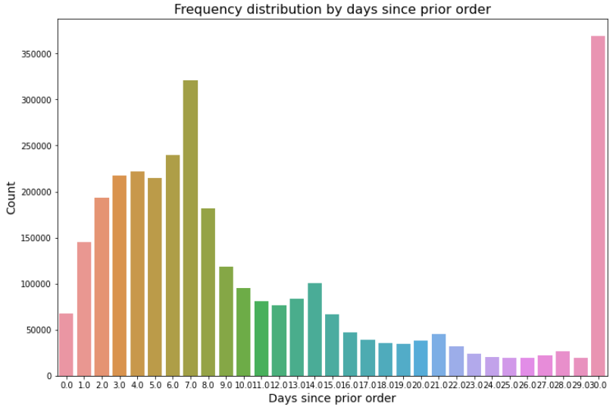
Days Since Prior Order
As per our analysis, the following observations were made
We can clearly see a hike on the 7th day indicating high weekly reorder
However we also observe a peak around the 30th day indicating a monthly reorder

Slide 11
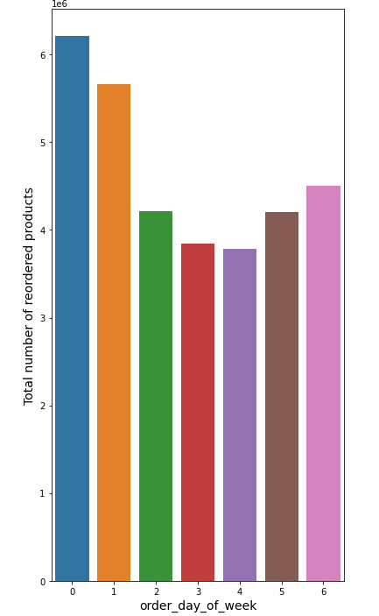
Analysis of Reorder Products
On analyzing the reordered products by day of week, we can see a similar trend with maximum number of reorders placed on Sundays and Mondays

Slide 12
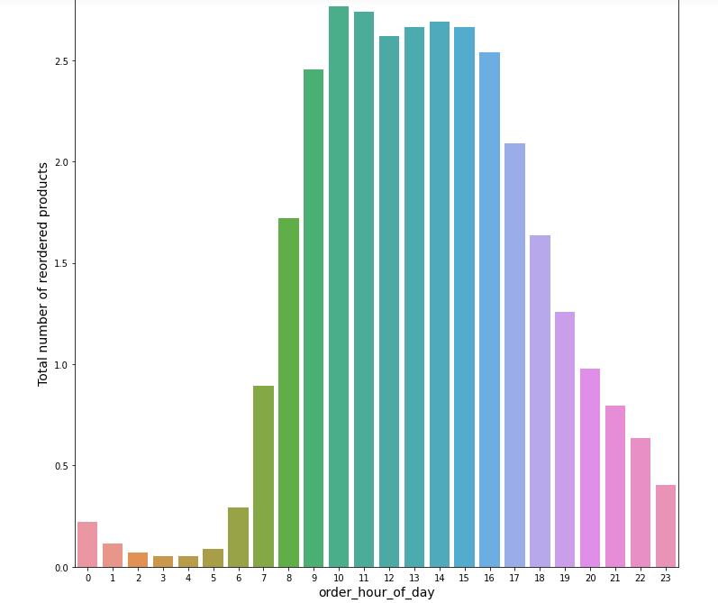
Analysis of Reorder Products
On analyzing, the reordered products with respect to the hour of the day, there is a clear hike in the orders placed between 10 Am and 5 Pm

Slide 13
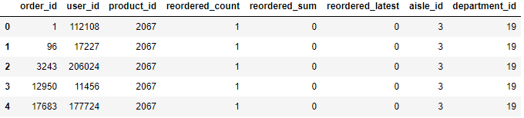
Preparing the Train Data Set
This is the set of independent features, the variable of interest is reordered

Slide 14
Algorithm Results (Accuracy)
Models | Accuracy Score
XGBoost Classifier | 90.47%
Logistic Regression | 90.19%
RandomForest Classifier | 90.44%
LightGBM Classifier | 90.46%

Slide 15
Recommendations
Depending on the peak sales time period, Instacart can run promotional campaigns on product categories complementing high demand product items
Based on customers’ historical purchase behavior, personalized promotional offers can be sent on product categories, the customer is most likely to purchase
During hours/days of peak orders, an increase in the delivery employees would help improve customer satisfaction

